Slide 1
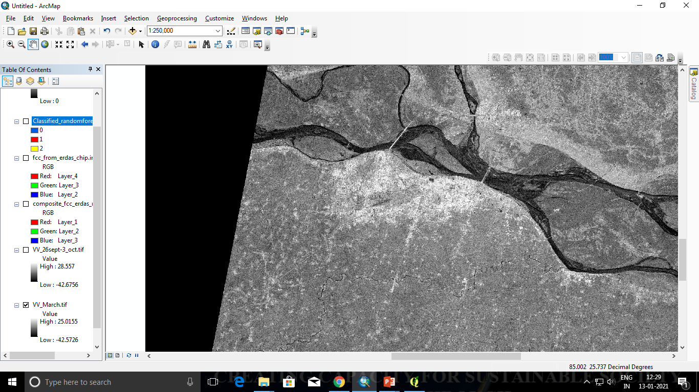
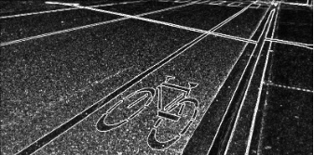
GNR 607 Programming Assignment: Hough Transform
Project Presentation
GNR 607: Satellite Image Processing
Nov 27,2022
Submitted to:
Prof. B K Mohan
CSRE
Presented by:
Amit Kumar 22M0330
Arunim Anand 214420001
Ganesh 22M0331
Jaishree Goyal 22M0309
Indian Institute of Technology Bombay

Slide 2
About Hough Transform

Slide 3
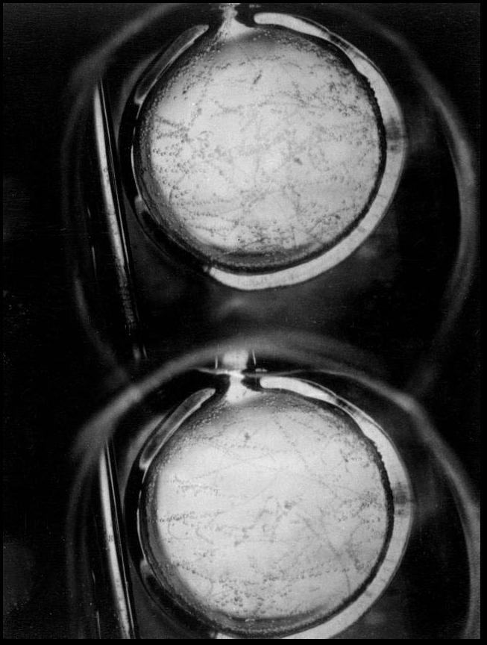
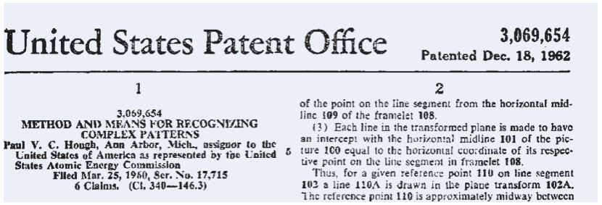
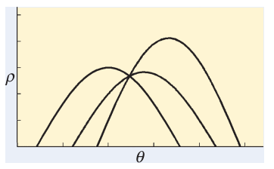
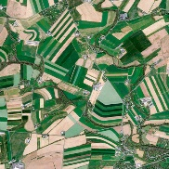
Introduction to Hough Transform
1959
Invented
A technique to isolate features of a particular shape within an image
Invented for
Machine analysis of bubble chamber photographs
Presently used in
image analysis,
computer vision, &
digital image processing
1962
Patent
1972
Parametrization
Digital image processing
Started with the identification of lines within an image, but later has been extended for other shapes, most commonly circles & ellipse
2000s
Satellite Image
Source: https://patents.google.com/patent/US3069654A/en , P. E. Hart, “How the Hough transform was invented [DSP History],” IEEE Signal Process. Mag., vol. 26, no. 6, pp. 18–22, Nov. 2009, doi: 10.1109/MSP.2009.934181.

Slide 4
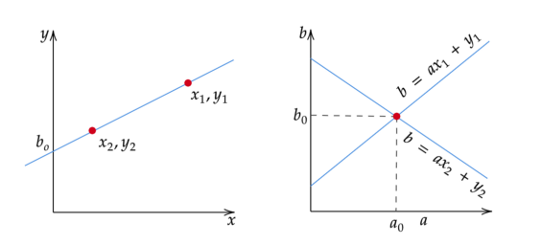
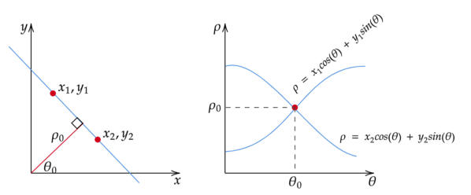
Introduction to Hough Transform
Motivation: Each coordinate pair in image space indicates its contribution to a globally consistent solution – say, a line or a circle or any object.
A line in the image space can be expressed with 2 variables:
In the Cartesian coordinate system: Parameters (m, c)
y = mx + c
The Hough Space is a 2D plane with horizontal axis representing the slope and the vertical axis representing the intercept of a line on the edge image.
In the Polar coordinate system: Parameters (r,θ)
r = xcosθ + ysinθ
The Hough Space is a 2D plane with r and θ, where the horizontal axis is for the θ values and the vertical axis is for the r values.
Source: “Image Transforms - Hough Transform.” https://homepages.inf.ed.ac.uk/rbf/HIPR2/hough.htm

Slide 5
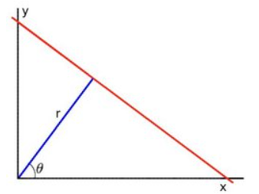
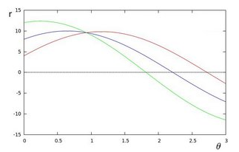
Fundamentals
In m-c form, it won’t be able to detect vertical lines because the slope m is undefined/infinity for vertical lines, also it requires large accumulator, more memory and computation. Thus, the polar form is preferred
In general for each point (x₀, y₀) , we can define the family of lines that goes through that point as:
r = x₀ cosθ + y₀ sinθ, orientation of θ is finite, r is finite.
For all the points in an image, if we plot the family of lines passing through them, we get sinusoids. This point-to-curve transformation is the Hough transformation for straight lines.
When viewed in Hough parameter space, points which are collinear in the cartesian image space become readily apparent as they yield curves which intersect at a common point.
Source: “Hough Line Transform — OpenCV 2.4.13.7 documentation.” https://docs.opencv.org/2.4/doc/tutorials/imgproc/imgtrans/hough_lines/hough_lines.html

Slide 6
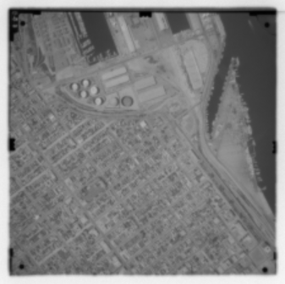
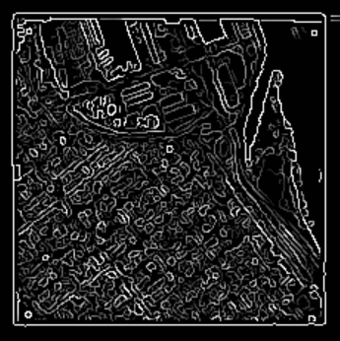
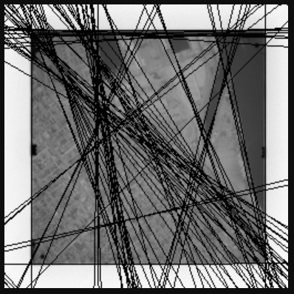
An Example from the literature review
Remote Sensing Image
Canny Edge Detector
Hough Transform
Source: “Image Transforms - Hough Transform.” https://homepages.inf.ed.ac.uk/rbf/HIPR2/hough.htm

Slide 7
The Code

Slide 8
Importing essential libraries
Numpy :
import numpy as np
Matplotlip.pyplot :
import matplotlib.pyplot as plt
Matplotlib.lines :
import matplotlib.lines as mlines
OpenCv :
import cv2
tkinter :
import tkinter as tk

Slide 9
Hough Transform function
Slope-intercept form
Polar form
Defining the transform function
Defining the transform function
def hough_transform(input_img, approach, threshold)
def hough_transform(input_img, approach, threshold)
The shape of an image is accessed by img.shape. It returns a tuple of the number of rows, columns
shape[:2] is an example of tuple unpacking, with it you extract the rows and columns values from the shape tuple
Extracting image size
Extracting image size
height, width = edge_image.shape[:2]
half_height, half_width = height / 2, width / 2
max_len = np.sqrt(np.square(height) + np.square(width))
height, width = edge_image.shape[:2]
half_height, half_width = height / 2, width / 2
max_len = np.sqrt(np.square(height) + np.square(width))
Accumulator Array formation
Accumulator Array formation
m_lst=np.arange(-200,200,step=1)
c_lst=np.arange(-200,200,step=1)
accumulator = np.zeros((len(m_lst), len(c_lst)))
dq = 180 / total_qs
dr = (2 * diagonal) / total_rs
qs = np.arange(0, 180, step=dq)
rs = np.arange(-diagonal, diagonal, step=dr)
accumulator = np.zeros((len(rs), len(qs)))

Slide 10
Hough Transform function
Slope-intercept form
Polar form
For each pixel
For each pixel
for y in range(height):
for x in range(width):
if edge_img[y][x] != 0:
edge_point = [y, x]
ys, xs = [], []
for m_indx in range(len(m_lst)):
c=-m_lst[m_indx]*x+y
m=m_lst[m_indx]
c_indx=np.argmin(np.abs(c_lst-c))
accumulator[c_indx][m_indx] += 1
ys.append(c)
xs.append(m)
for y in range(height):
for x in range(width):
if edge_image[y][x] != 0:
edge_point = [y - edge_height_half, x - edge_width_half]
ys, xs = [], []
for q_idx in range(len(qs)):
r = (edge_point[1] * cos_qs[q_idx]) + (edge_point[0] * sin_qs[q_idx])
q = qs[q_idx]
r_idx = np.argmin(np.abs(rs - r))
accumulator[r_idx][q_idx] += 1
ys.append(r)
xs.append(q)
#checking for white pixels
#shifting origin
#finding r value
#saving q values to variable
#subtracting r from list of r and finding index of minimum
#incrementing accumulator with index of r and q
#saving (b,a) values or (r,q) values

Slide 11
Hough Transform function
Slope-intercept form
Polar form
Looping through accumulator
Looping through accumulator
for y in range(2,accumulator.shape[0]-2):
for x in range(2,accumulator.shape[1]-2):
if accumulator[y][x] > threshold:
c = c_list[y]
m = m_list[x]
x1 = 1000+width_half
y1 = a*x1+b
x2= -1000+width_half
y2= a*x2+b
subplot3.plot([m], [c], marker='H', color="red")
subplot4.add_line(mlines.Line2D([x1, x2], [y1, y2]))
for y in range(accumulator.shape[0]):
for x in range(accumulator.shape[1]):
if accumulator[y][x] > threshold:
r = rs[y]
q = qs[x]
a = np.cos(np.deg2rad(q))
b = np.sin(np.deg2rad(q))
x0 = (a * r) + edge_width_half
y0 = (b * r) + edge_height_half
x1 = int(x0 + 1000 * (-b))
y1 = int(y0 + 1000 * (a))
x2 = int(x0 - 1000 * (-b))
y2 = int(y0 - 1000 * (a))
subplot3.plot([q], [r], marker='o', color="red")
subplot4.add_line(mlines.Line2D([x1, x2], [y1, y2]))
#checking for threshold
#plotting m-c space & r-q space
#plotting lines

Slide 12
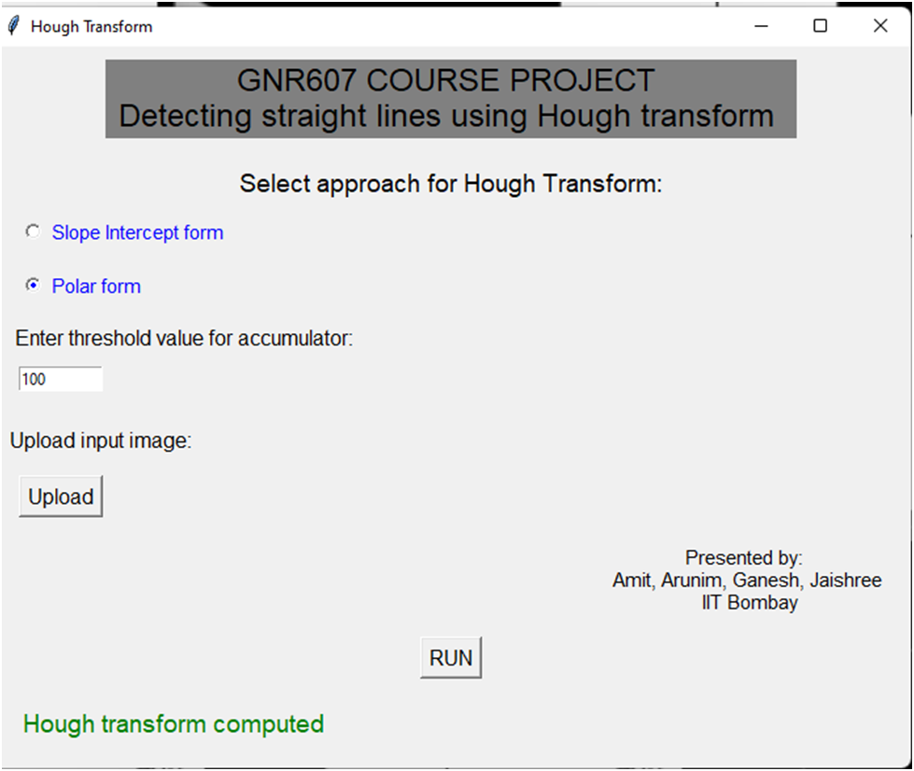
Hough Transform GUI
The UI requires an input image, threshold and approach to compute Hough Transform
Generated with the help of tkinter library in jupyter notebook

Slide 13
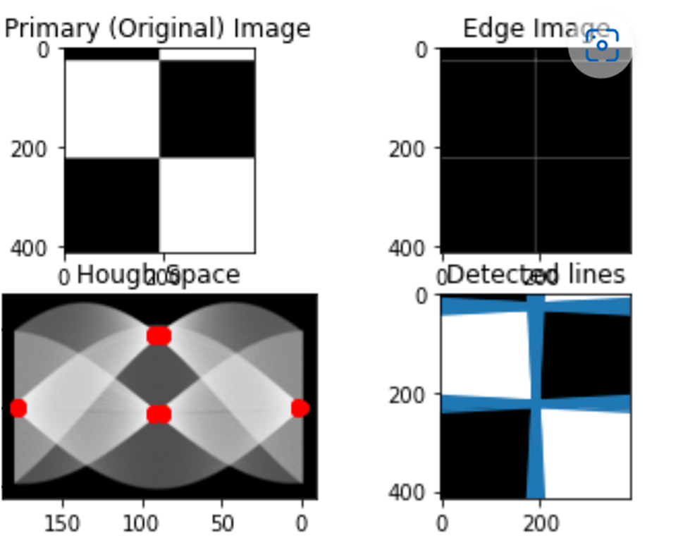
Hough Transform - Result
Red markers show the peaks in hough space, and the blue lines are detected shown overlaying on the original image

Slide 14
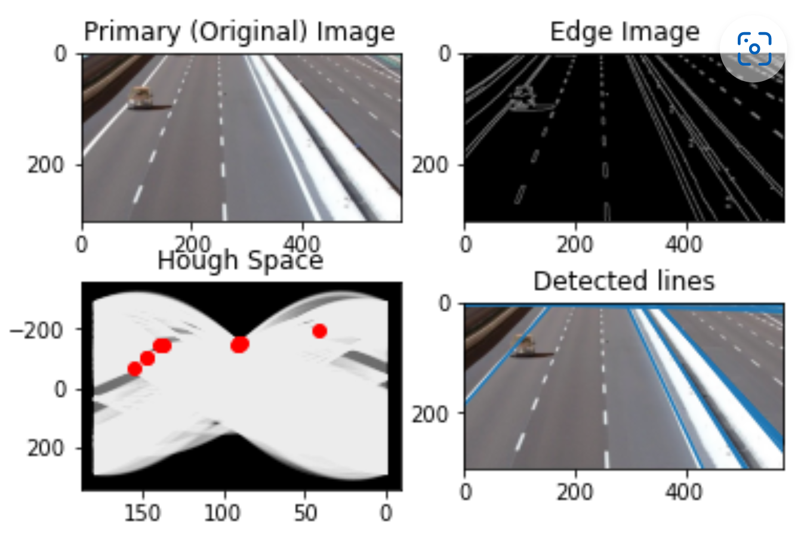
Hough Transform - Result
Red markers show the peaks in hough space, and the blue lines are detected shown overlaying on the original image

Slide 15
Hough Transform - Challenges
Computation time is high for larger sized images such as camera photographs and satellite images
The lines may not represent the exact size of the features in the image

Slide 16
References
[1] D. H. Ballard, “Generalizing the Hough transform to detect arbitrary shapes,” Pattern Recognit., vol. 13, no. 2, pp. 111–122, Jan. 1981, doi: 10.1016/0031-3203(81)90009-1.
[2] “Image Transforms - Hough Transform.” https://homepages.inf.ed.ac.uk/rbf/HIPR2/hough.htm
[3] “Hough Line Transform — OpenCV 2.4.13.7 documentation.” https://docs.opencv.org/2.4/doc/tutorials/imgproc/imgtrans/hough_lines/hough_lines.html
[4] R. O. Duda and P. E. Hart, “Use of the Hough transformation to detect lines and curves in pictures,” Commun. ACM, vol. 15, no. 1, pp. 11–15, Jan. 1972, doi: 10.1145/361237.361242.
[5] O’Gorman and Clowes, “Finding Picture Edges Through Collinearity of Feature Points,” IEEE Trans. Comput., vol. C–25, no. 4, pp. 449–456, Apr. 1976, doi: 10.1109/TC.1976.1674627.
[6] P. E. Hart, “How the Hough transform was invented [DSP History],” IEEE Signal Process. Mag., vol. 26, no. 6, pp. 18–22, Nov. 2009, doi: 10.1109/MSP.2009.934181.
[7] P. V. C. Hough, “Method and means for recognizing complex patterns,” US3069654A, Dec. 18, 1962 Accessed: Nov. 25, 2022. [Online]. Available: https://patents.google.com/patent/US3069654/en
[8] https://patents.google.com/patent/US3069654A/en

Slide 17
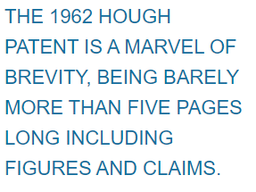
Thank You

